Slide 1

Android : Unit Testing Best Practices Prefer Fakes over Mocks
Venkat Ballem
Android Engineer

Slide 2
Background
Traditional unit tests often rely heavily on mocks to simulate dependencies.
Mocking frameworks (like MockK) introduce extra setup and can slow down tests.
Over-mocking leads to brittle tests tied to implementation details.
Fakes are lightweight, real implementations with controlled behavior.
Industry best practices now favor Fakes for faster, more reliable tests.

Slide 3
Agenda
Test Doubles
Prefer Fakes over Mocks
Best Practices: When to Use What
Regular
Network API
Database
Android Framework
Q&A

Slide 4
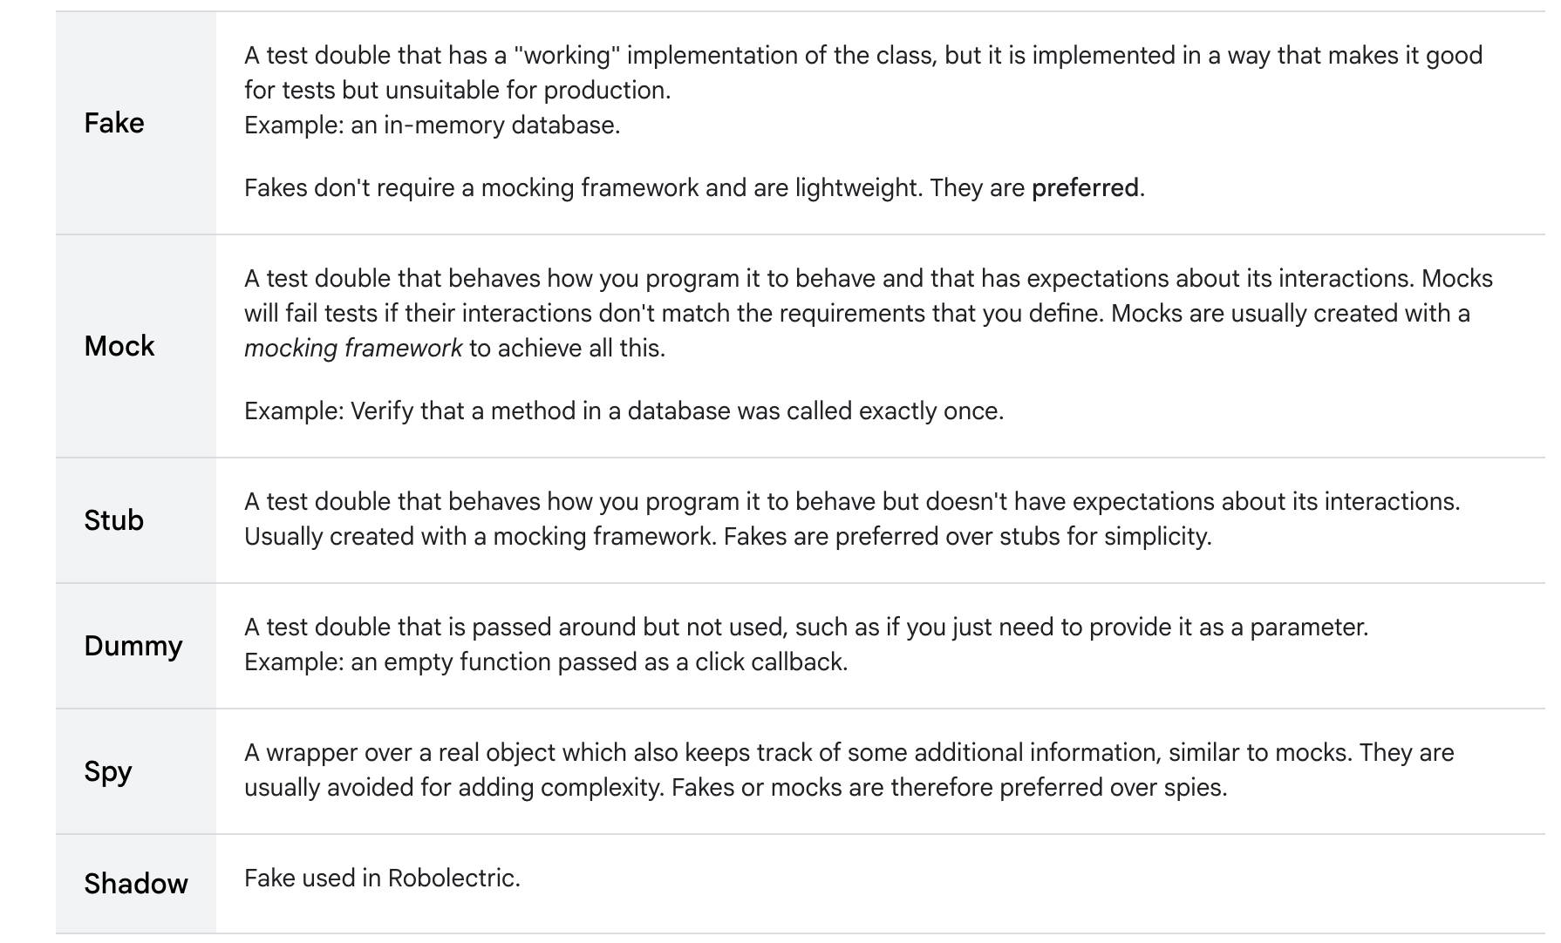

Test Doubles

Slide 5
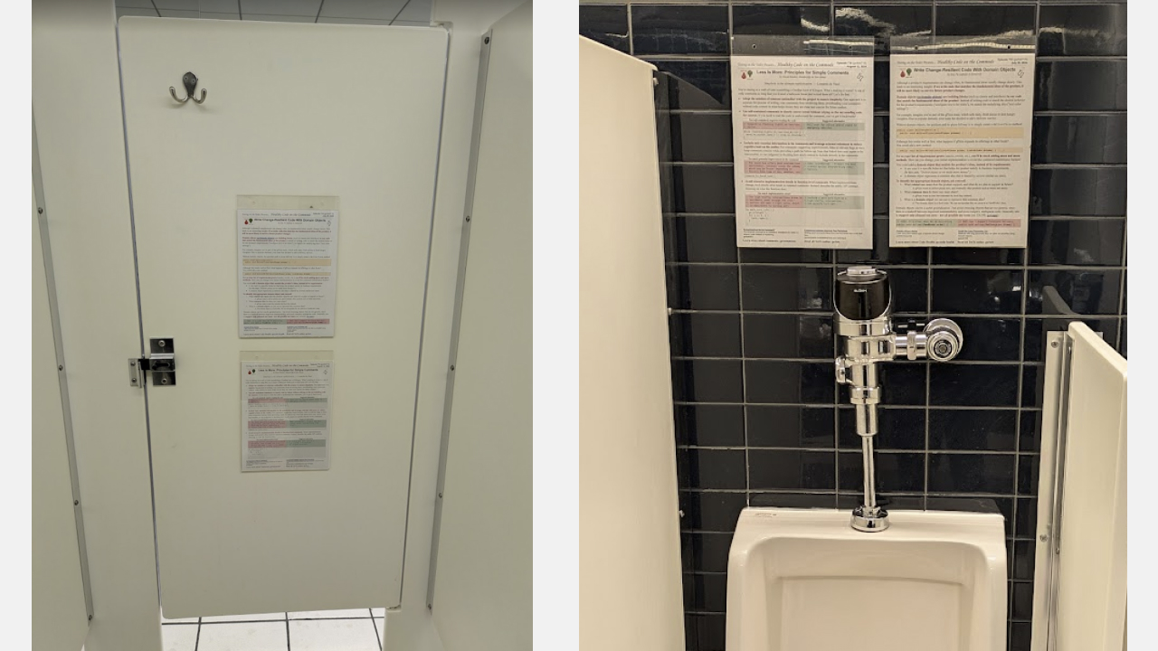
Testing on the Toilet

Slide 6
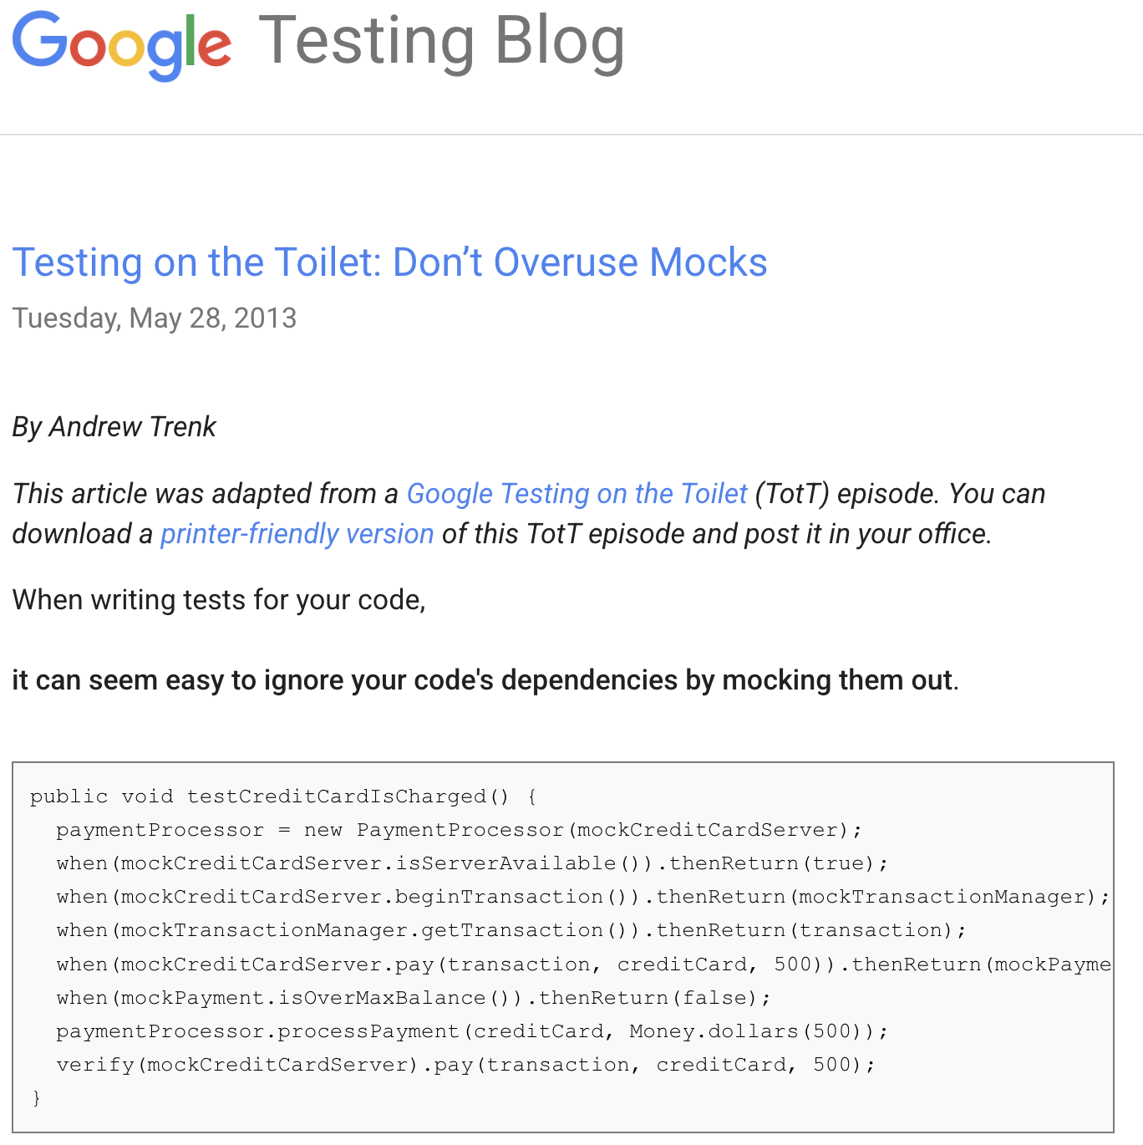
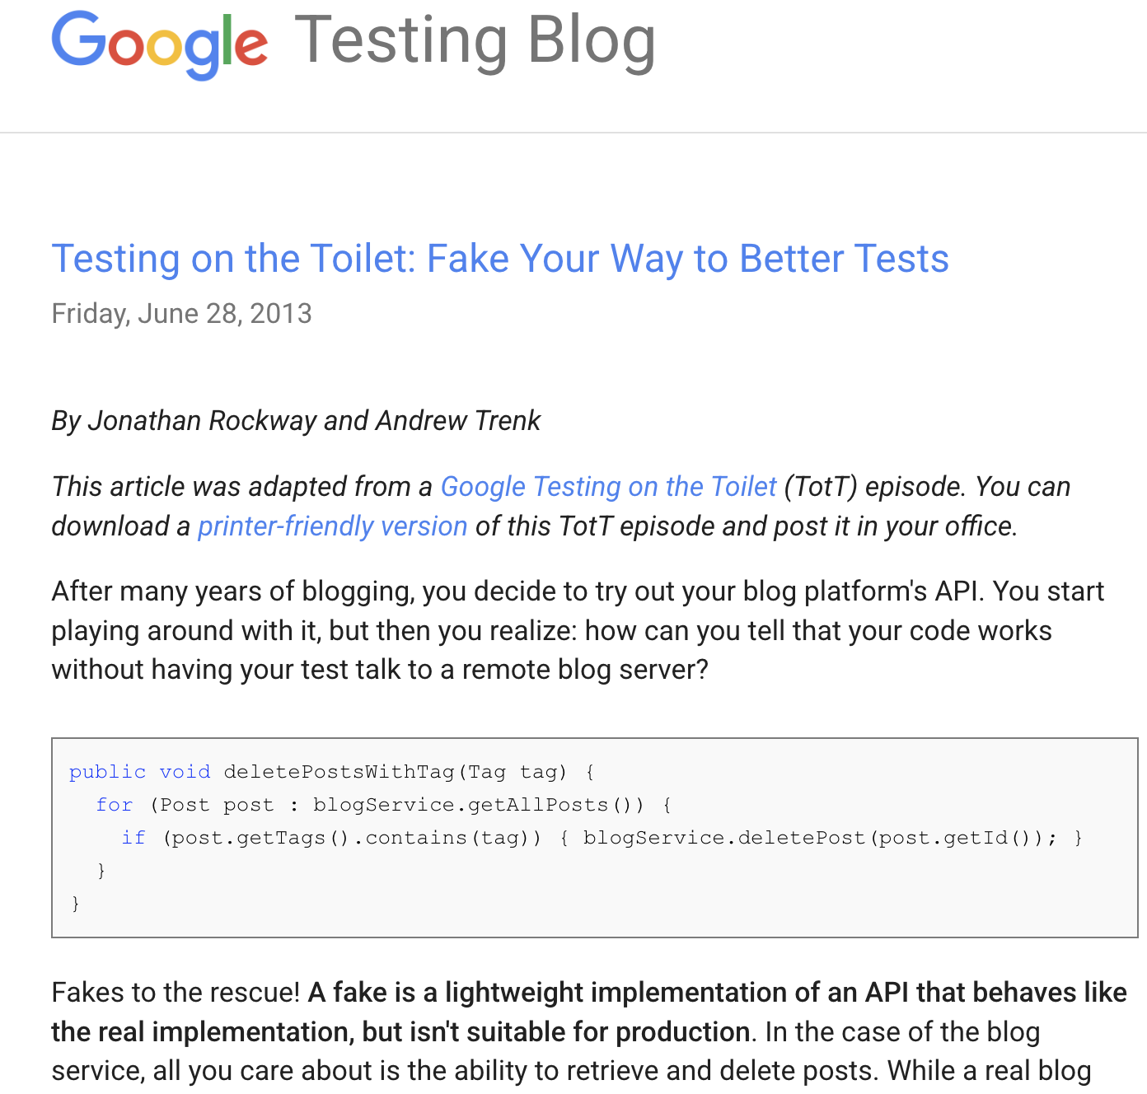
Testing on the Toilet
source: https://testing.googleblog.com/2013/06/testing-on-toilet-fake-your-way-to.html
source: https://testing.googleblog.com/2013/05/testing-on-toilet-dont-overuse-mocks.html

Slide 7

Prefer Fakes over Mocks
Aspect | Fake (Custom Simple Implementation) | Mock (MockK, Mockito)
Execution Speed | Very fast (in-memory, no reflection) | Slower (framework overhead, proxy generation)
Time to Write | Medium — needs simple in-memory logic implementation | Low — generated instantly via frameworks
Maintenance | Low — stable once written | High — breaks easily with method signature changes
Debuggability | Easy — behaves like real class | Hard — needs trace through mocking logic or verification
Readability | High — looks like actual business logic | Moderate — readable only if familiar with mocking style

Slide 8
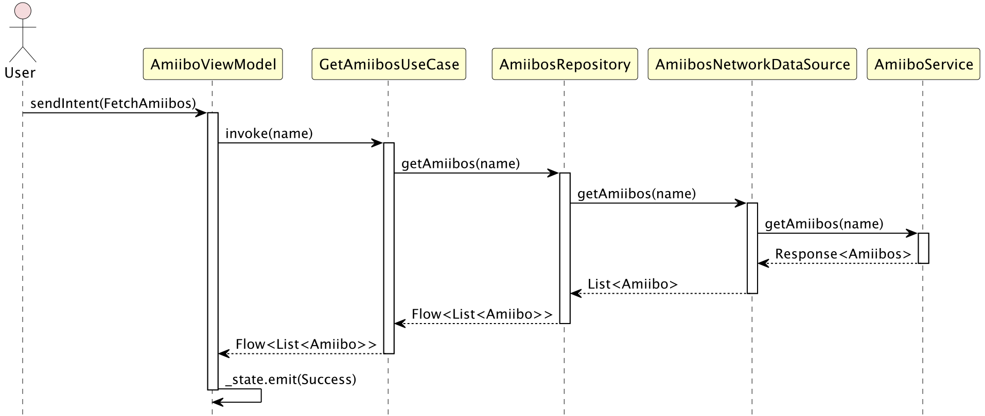
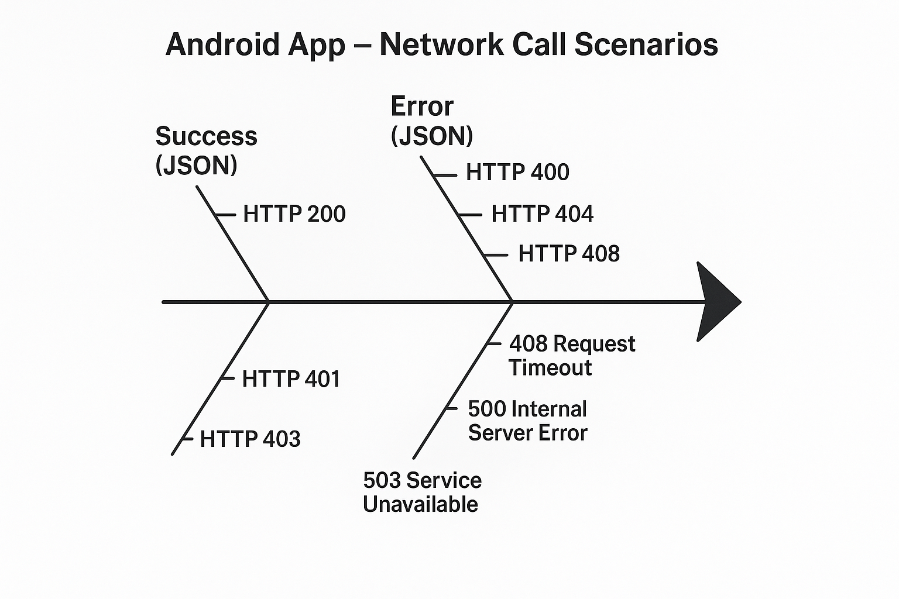
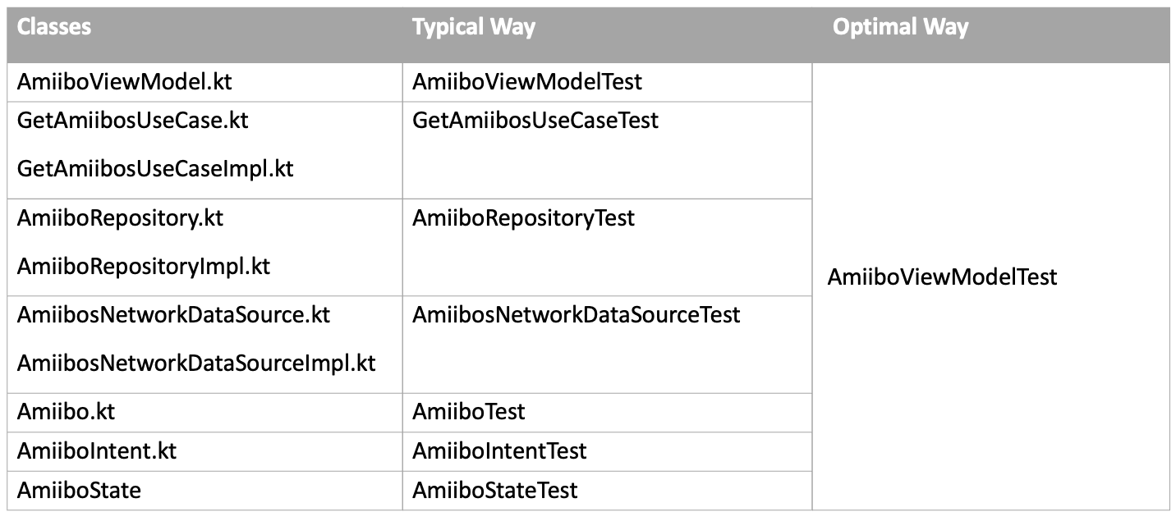
Scenario: Network API
Realistic Simulation
Retry Logic
Timeout
Network latency
Headers
Request/response tracking
REST: okhttp-mockwebserver
GraphQL: apollo-kotlin-mockserver
Fish bone diagram

Slide 9
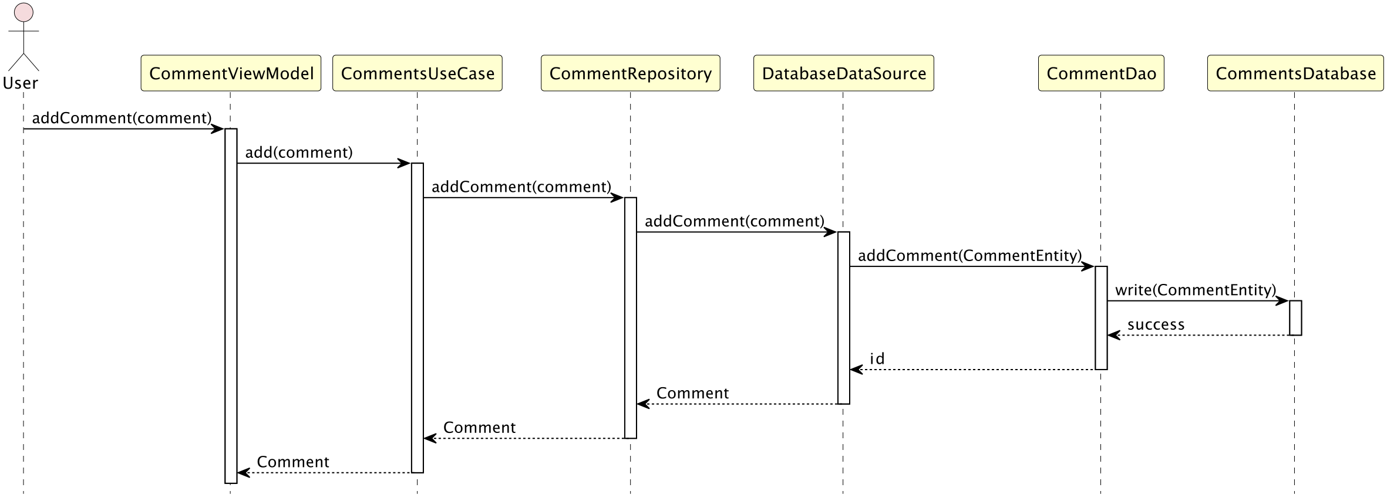
Scenario: Database API
Prefer in-memory database like Room In-MemoryDatabase
Tests real SQL queries & schema constraints
No need to mock every DAO function manually
Detects issues with Room annotations, migrations
Reflects real database behavior (e.g., insert-conflict)
Ensures end-to-end data flow is correct

Slide 10
Scenario: Android Framework API
Third-Party SDKs
e.g., Firebase, Payment APIs
Android Framework Classes
Context
SharedPreferences
LocationManager
NotificationManager
ClipboardManager etc.
Static/Final Classes
e.g., TextUtils.isEmpty
Build.VERSION.SDK_INT, TextUtils.isEmpty()..etc
Places where you can’t be able to use Fakes.

Slide 11
Reference Links
https://developer.android.com/training/testing/fundamentals/test-doubles#types
https://testing.googleblog.com/2013/06/testing-on-toilet-fake-your-way-to.html
https://testing.googleblog.com/2013/05/testing-on-toilet-dont-overuse-mocks.html
https://martinfowler.com/bliki/TestDouble.html
https://www.artofunittesting.com/
https://www.amazon.com/Art-Unit-Testing-examples/dp/1617290890
https://developer.android.com/training/testing/fundamentals
https://learn.microsoft.com/en-us/archive/msdn-magazine/2007/september/unit-testing-
exploring-the-continuum-of-test-doubles

Slide 12
Q/A

